Slide 1
Team Money
Representing Marathon Grill

Slide 2
TEAM MONEY
Melissa Noucas
Design and Merchandising
Danyel Deiter
International Area Studies
Sarah Fagan
Marketing
Prant Kumar
Finance
Greg Ferrara
Marketing and Accounting

Slide 3
Manager Interview
Purpose:
Find problems with current advertisements
Reveal target markets the restaurant is attempting to capture
Discover which meal segment the restaurant is looking to target

Slide 4
SWOT Analysis

Slide 5
Strengths
Quality and variety of food
Convenience of locations
Food priced fairly
Customer loyalty

Slide 6
Weaknesses
Flyers ads only
Lack of poster-sized ads in the restaurant
Ads mainly concentrated on location
Not enough external advertisment

Slide 7
Opportunities
Capture younger crowd
Advertise Happy Hour and Center City SIPS
Capture a nighttime crowd

Slide 8
Threats
Low customer awareness
Existing ads lack impact on the younger crowd
Economic problems

Slide 9
Customer Interview
Purpose:
Discover…
what ads customers had seen
in what ways customers would like to see Marathon Grill improve
if customers thought of Marathon as a place they would go for dinner
if customers consider Marathon Grill as a popular place to go for after-dinner drinks

Slide 10
One-to-One Interviews
Face-to-face interviews with people who had been to Marathon Grill at least once
Each member interviewed five people during the week of July 27th
Group targeted was customers ages 18-25
84% of customers interviewed fell into this bracket
Interviews took place on Drexel University’s campus

Slide 11
On-Site Surveys
Short, 1-page survey distributed to customers as they ate
Collect data while the experience was fresh in their mind
The purpose of the survey was to reveal:
More demographic information about the customers
Why they chose to eat at Marathon Grill
If they knew that Marathon Grill participates in Center City SIPS and Philadelphia Restaurant Week

Slide 12
Interview Findings

Slide 13
Demographics
Males: 64%
Females: 36%

Slide 14
Dining Results

Slide 15
Reason for Dining

Slide 16
Service and Food Quality
How would you rate the service you received? 1 being poor, 5 being excellent.
How would you rate the quality of the food? 1 being poor, 5 being excellent.
1 _ 0/24
2 _ 3/24
2.5 _ 1/24
3 _ 3/24
4 _ 14/24
5 _ 3/24
Avg: 3.7
1 _ 0/24
2 _ 1/25
3 _ 9/25,
3.5 _ 1/25
4 _ 12/25
5 _ 2/25
Avg. 3.6

Slide 17
Ad Recall
If “Yes”, where: In-store __ 3
Online __ 2
Philadelphia Metro __ 1
CC Sips Ad __ 1

Slide 18
Dinner and Bar Crowd
Do you consider Marathon Grill as a choice for dinner destinations?
Yes __ 18/25
No __ 7/25
Do you consider Marathon Grill as a popular destination for the after-dinner drink crowd?
Yes __ 8/25
No __ 17/25

Slide 19
Enhancing the Customer Experience

Slide 20
Survey Findings

Slide 21
Demographics
Age
Location

Slide 22
Reason for Dining
What brought you here today?
Loyal customer __ 8/15
Word of Mouth __ 2/15
Tourism Break __ 1/15
Center City Sips __ 1/15
Other:
Convenience, Hungry, Prior Experience

Slide 23
Promotional Awareness

Slide 24
SWOT Analysis

Slide 25
Strengths
Quality of food
“Diverse menu”
“Food was wonderful”
“Good drink specials”
Price
“I think the quality of the food is appropriate for its price…”

Slide 26
Strengths
Service
“The service was overall pretty fluid”
“…expedient service…”
“…service was pretty good, staff was friendly”
Atmosphere
“I enjoy the atmosphere at Marathon”
“Atmosphere was pretty cool”

Slide 27
Weaknesses
Sales Promotions
“More promotions”
“More specials on food and drinks”
“Incentives to come more often”
“Maybe they should give some discounts to loyal customers who can be considered regulars”

Slide 28
Weaknesses
Advertisements
Would like to see…
“…more advertisements”
“…better SIPS advertisement”
“…more print ads outside of restaurant”
“Need to branch outside loyal customers”
“Advertise things that they do”
Advertise bar/happy hour

Slide 29
Weaknesses
Better service
Menu
“Have a set 3 course menu”
“Changing up their menu would be cool”
Consistency of food

Slide 30
Weaknesses
Atmosphere
“The only possible betterment would be live entertainment, i.e. a band, solo artist, comedian, etc.”
“If they want to be an after-dinner drink place they need to create the atmosphere.”
“It would be nice to see a younger crowd, maybe in their middle 20’s in there to drink”
“Didn‘t get a young vibe, people were in their 70‘s…Want more of a young, hip atmosphere.”

Slide 31
Weaknesses
Table arrangements
“The tables were way too close together making it difficult to have a night out without feeling like my entire conversation was being listened to by strangers.”
“The only real problem I’ve had is that the seats are too close to one another. Sometimes it gets too loud and makes it harder to eat and enjoy yourself with everyone being so close.”
Bar
“The bar’s too small though, they should add on to it.”

Slide 32
Opportunities
Local events
Center City SIPS
Philadelphia Restaurant Week
Philadelphia Dining Days
Convenient location
“Very convenient to my work so I go there for lunch.”

Slide 33
Threats
Obstacles
Building size
Competition
Better ads
Better atmosphere
Website
17 out of the 25 customers interviewed (68%) have never visited Marathon Grill’s website.

Slide 34
Manager v. Customer
Similarities
Strengths
Food and Service
Quality of the food
Overall low prices
Fast, efficient service
Friendly, personable atmosphere
Diverse menu

Slide 35
Manager v. Customer
Similarities
Weaknesses
Both agreed that advertisements were lacking
They would like to see a younger crowd, especially during the happy hour and after-dinner times

Slide 36
Manager v. Customer
Similarities
Opportunities
Create more advertisements
Advertise happy hour, Center City SIPS, Restaurant Week, and Philadelphia Dining Days

Slide 37
Manager v. Customer
Similarities
Threats
Restaurants and bars located close to Marathon.
Since many do not believe Marathon to be a popular place for after-dinner drinks, they will most likely opt to visit their competitors.
Since some were looking for live entertainment and better seating arrangements, they will probably go to places that have these.

Slide 38
Manager v. Customer
Differences
Something the manager never mentioned that the customers found to be a big problem was the seating arrangements.
Many customers complained that the seats were too close to one another and the problem got worse as it became more crowded.

Slide 39
Manager v. Customer
Differences
The manger had said that while the bar is small, they make room in the back part of the restaurant for the bar crowd.
The customers thought that they should just make the bar bigger instead.

Slide 40
Current Ads

Slide 41
Current Ads
Very few ads to begin with
Most were print, i.e. fliers
Majority of people have never seen a Marathon ad
The problem is that they were only handed out in the store to existing customers

Slide 42
Current Ads
The ad’s color scheme consists of black, orange, blue, and white
Overall, they were dull
Nothing in the ads suggested Marathon to be “hip”
Very wordy

Slide 43
Current Ads
None of the ads were geared toward a bar crowd
Most of the ads depict a daytime scene
No customers or people were pictured

Slide 44
Current Ads
There were some consistencies
Font and colors remained the same throughout
Marathon logo was present in all
Telephone numbers and locations were on most ads

Slide 45
Web Presence
Marathon also has a website
Website just as boring as ads
No information about the history of the company
Random pictures, including Tinkerbell

Slide 46
Current Ads - Shortcomings
No Center City SIPS ads
No bar ads
Dull image
Failure to grab the attention of the target market
Hard to access ads
All of these are the reason Marathon’s ads are not effective

Slide 47
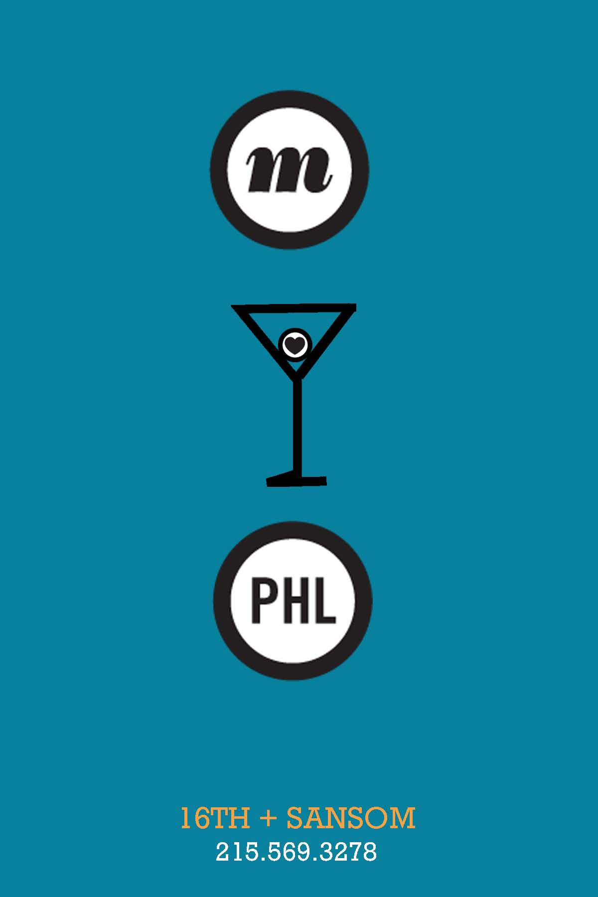
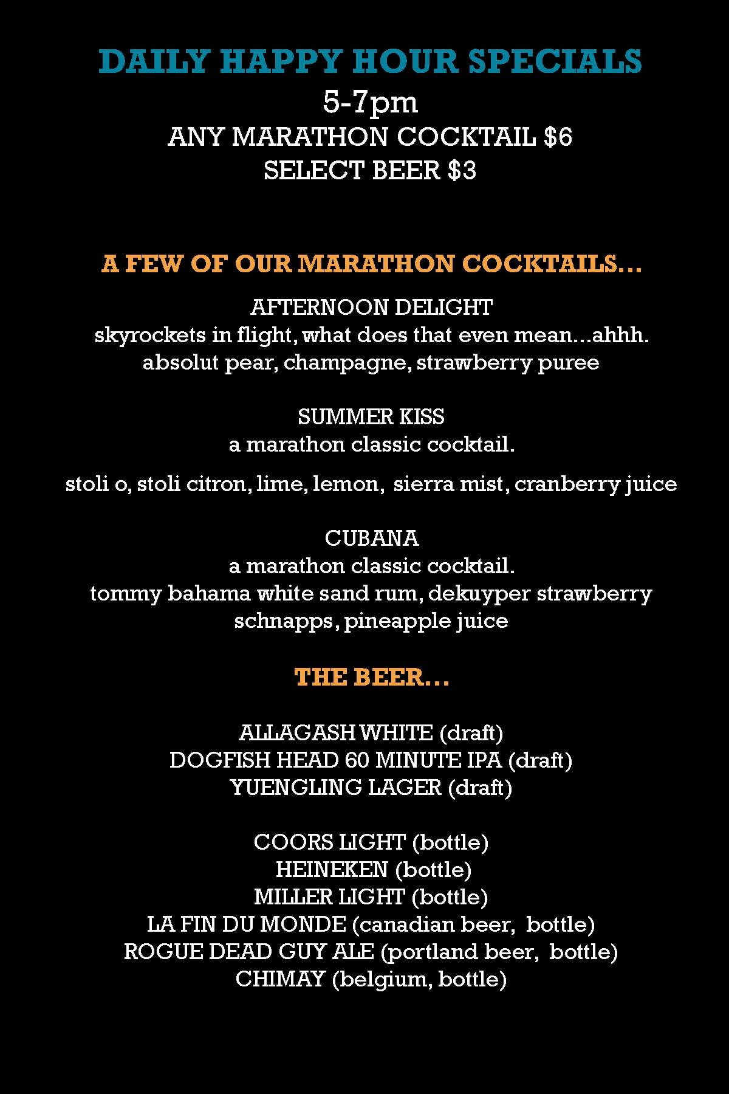
Our Ads
FRONT
BACK

Slide 48
Why we chose these mediums
Poster
The largest form of advertisement used by Marathon is a flyer
Able to be displayed in a window so people outside can see what Marathon has to offer
Can be scaled down and used as a magazine or newspaper ad
Postcard
Perfect to put on tables, in the front of the restaurant, and at the bar
Acts as a “moving advertisement”

Slide 49
Logo
Use the elements of the Marathon logo “M <heart> PHL”
Added the martini glass, put the heart inside the garnish – “Happy Hour”
Kept logo similar to Marathon’s already recognizable current logo
Black and white to stand out against colors in background

Slide 50
Colors
Chose the main colors used on previous flyers: blue, orange, white and black
Goal was to maintain the established brand image, but slightly update it

Slide 51
Poster
Orange is the brightest in our color palette
Walls of the 16th and Sansom location are blue
The teal, white and black text stand out and are easy to read on the orange ad

Slide 52
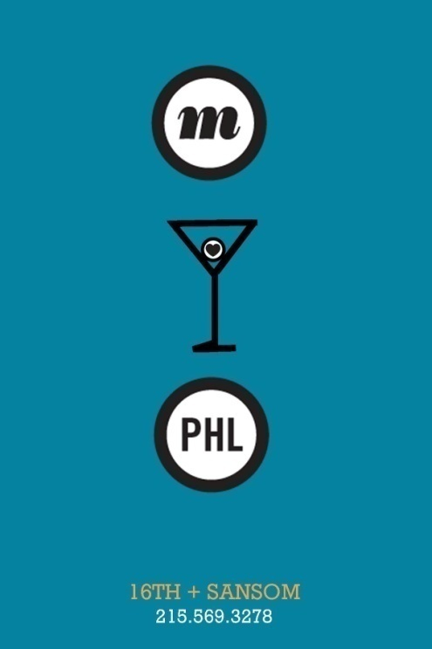
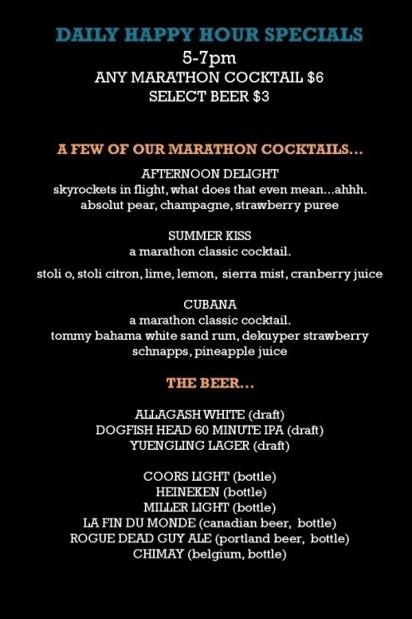
Postcard
Used the blue for the front of the postcard, and black as the back
White and orange used as accent colors
Most text is white, so it stands out the most

Slide 53
Our Font
Closely matches the font used in most other Marathon ads
It’s clean, but a little funky, and fits well with the rest of the ad
Font used in logo did not change

Slide 54
Poster
Pricing and time information to inform and remind potential customers
Location
“Marathon cocktails”
By “Serving” the neighborhood

Slide 55
Postcard
(FRONT) logo, location, and phone number
(BACK) information about happy hour, Marathon Cocktails and beer, “serving” the neighborhood to reinforce slogan

Slide 56
What our ad is responding to
Customers’ lack of awareness, but expressed interest of happy hour at 16th and Sansom
Manager’s desire to draw in a happy hour crowd
None of the previous ads seemed to convey a message

Slide 57
Why our ads are successful
Simple and clean, but clearly communicate our message
The poster is bright, eye-catching, and large enough to be noticed
The postcard is the perfect size to hand out, and contains just enough information
Incorporate Marathon’s already established logo, and build awareness and possible brand knowledge of Marathon Cocktails

Slide 58
Ad Comparison

Slide 59
Ad Comparison
Updated colors are brighter and send a “hip” message
Updated logo and martini glass are incorporated for a happy hour appeal
We’re promoting something!!
Kept consistent with location and contact information display
Text is kept to a minimum where possible

Slide 60
Recommendations

Slide 61
Recommendations
Pain points identified:
Low customer awareness regarding happy hour at Marathon Grill (16th and Sansom)
Not enough ads outside of the restaurant
Existing ads don’t have enough impact on younger target market

Slide 62
Recommendations
Low customer awareness regarding happy hour
Utilize the poster in high-traffic areas and as a backdrop to the bar
Use the postcard to reinforce happy hour specials and after-dinner drink options

Slide 63
Recommendations
Not enough ads outside of the restaurant
Postcards can be used as “mobile messages”
Send postcards to customers through direct mail
Accompany delivery orders
Posters can be blown up and placed throughout the mass transit system

Slide 64
Recommendations
Existing ads don’t have enough impact on younger target market
Use ads that depict younger individuals
Promote events such as Marathon Happy Hour and Center City SIPS
Use sales promotions for youthful events
Free happy hour, bar tab, etc.

Slide 65
Thank you for your time and attention!
Questions?

